Slide 1


Community Wealth Building
Fife Leadership Summit
Neil McInroy
Senior Fellow Global Advancement for Community Wealth Building and Community Wealth Building Adviser with Scottish Government

Slide 2
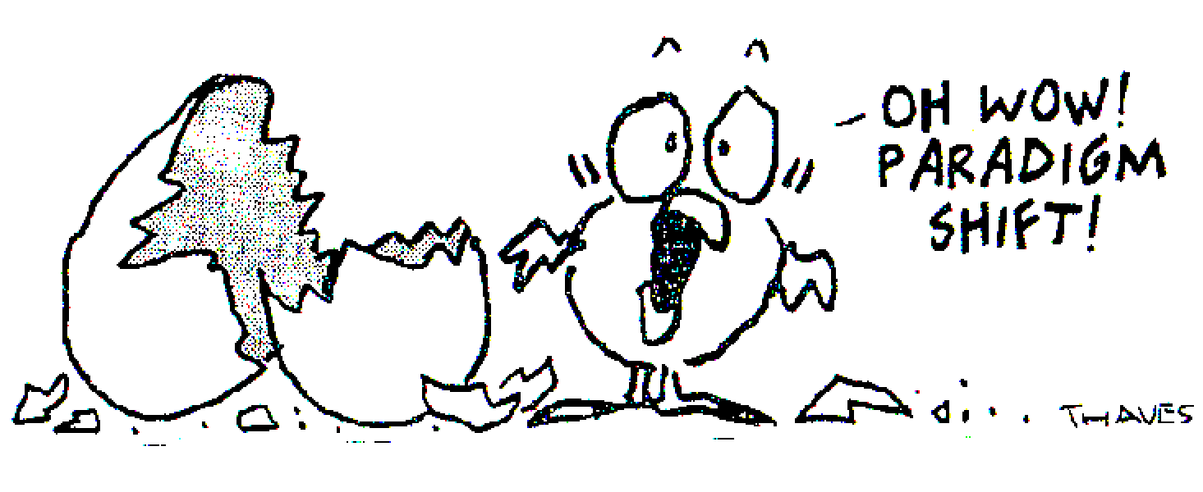
Megatrends and Huge crisis
How to transform Economy
The need for Collective public service
Leadership and need for innovation and Experiments

Slide 3
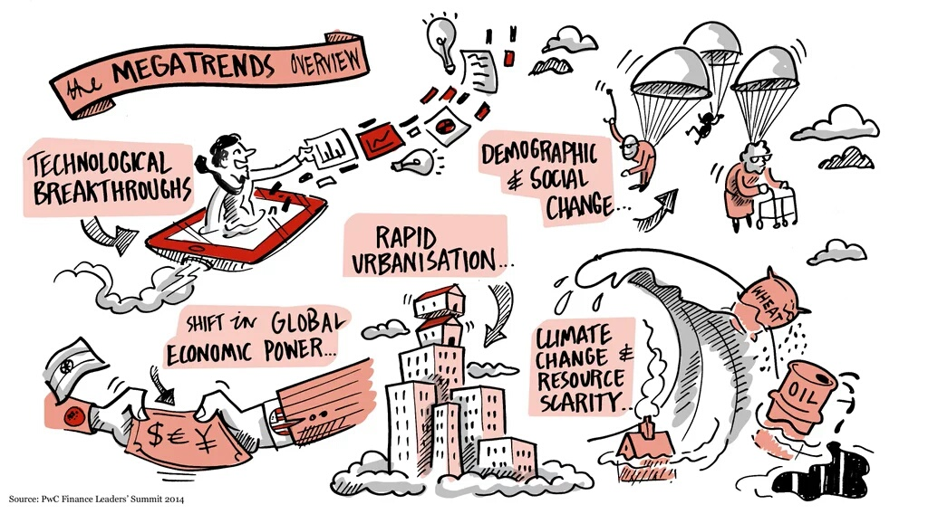
Huge crisis
Megatrends and crises times

Slide 4
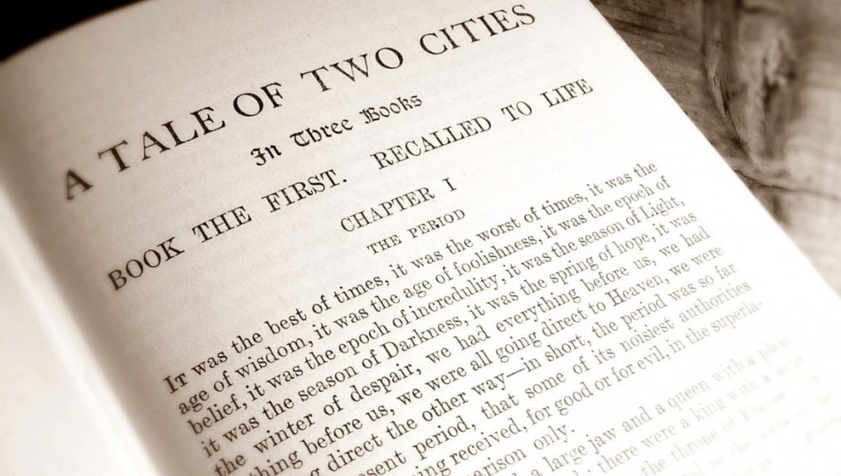
Challenging times
Notes:
Interregnum
It was the worst of times, it was the age of wisdom
Age of foolishness, it was the epoch of belief

Slide 5
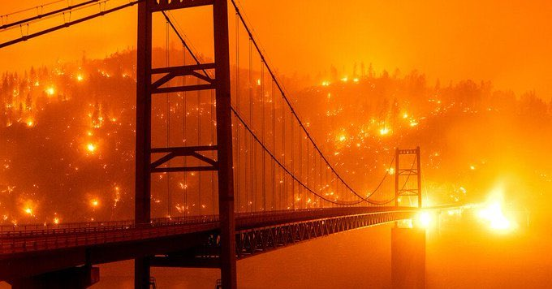
The climate horrors are here

Slide 6
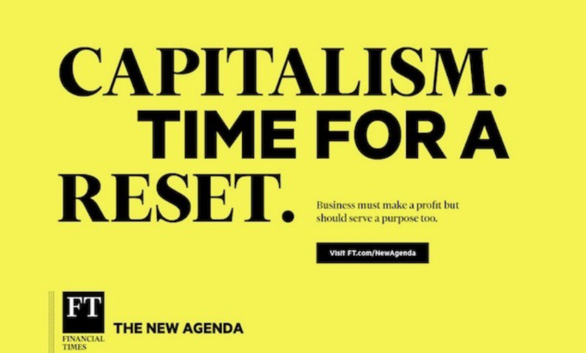
Financial Times
18th of September 2019

Slide 7
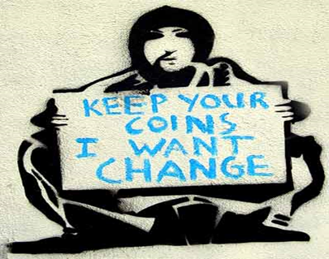
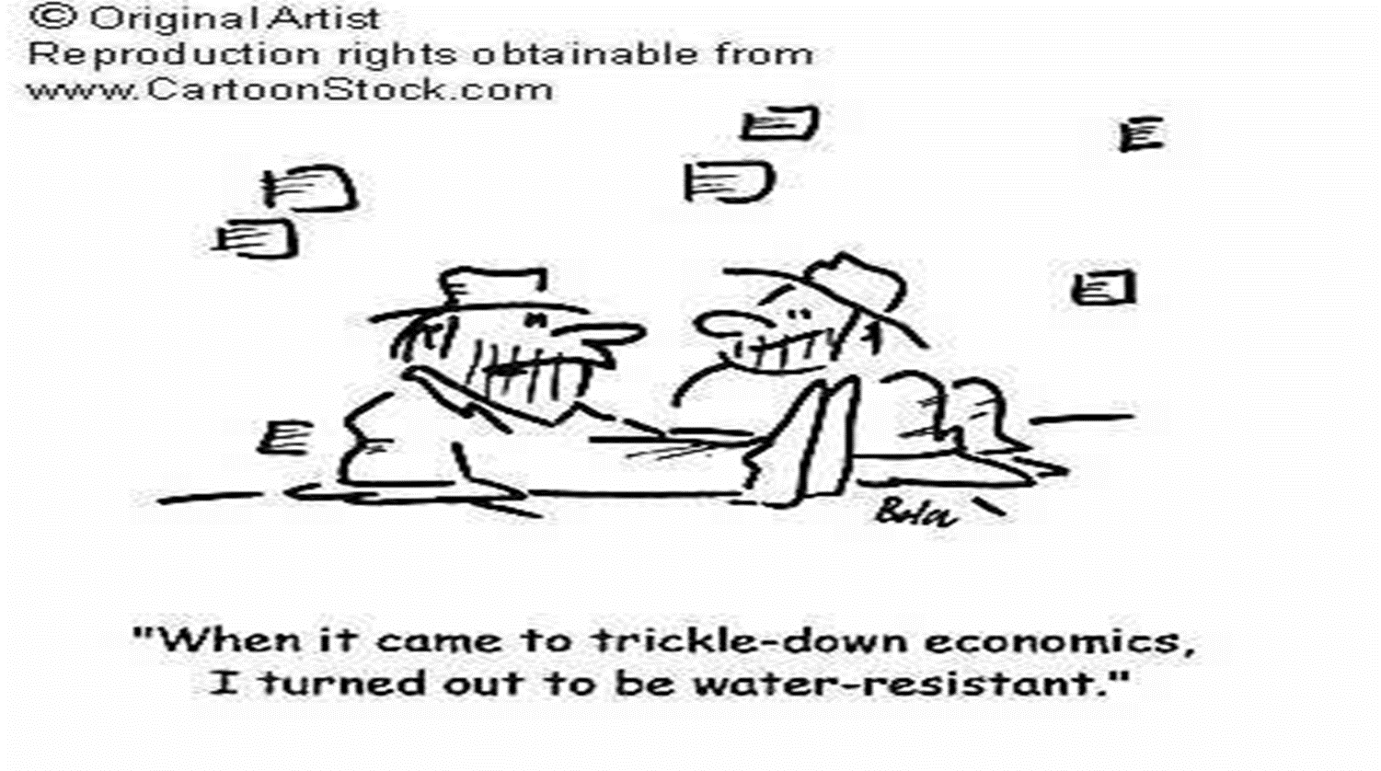
All Change
Transform economy

Slide 8

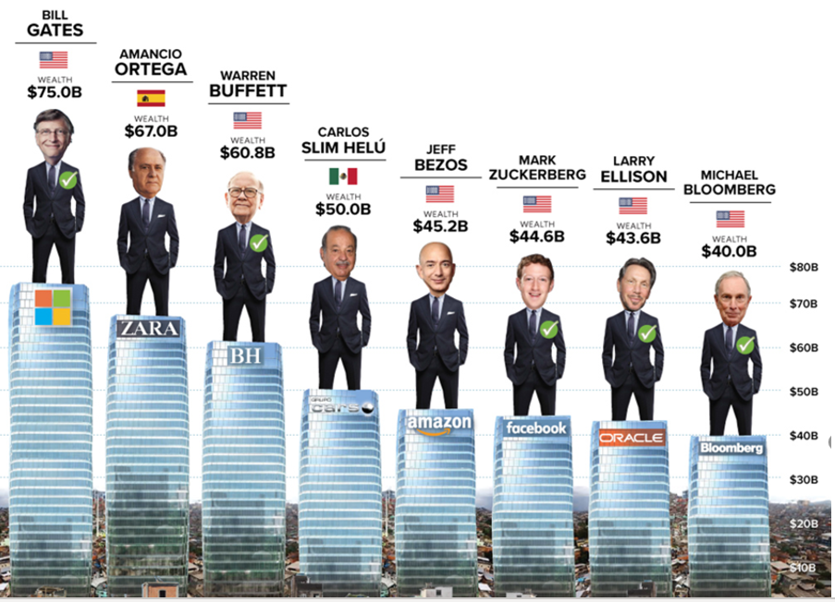
We have a wealth problem

Slide 9
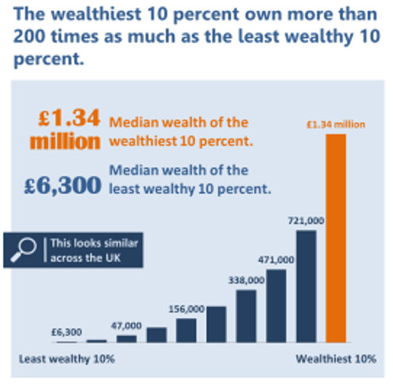
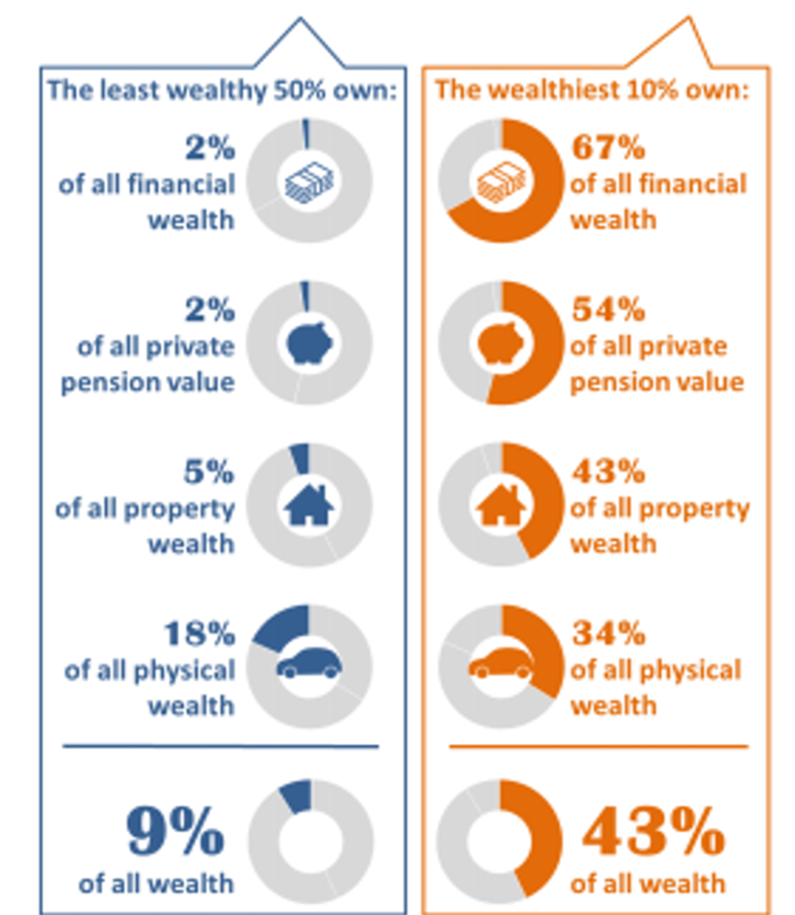
We have a wealth problem

Slide 10
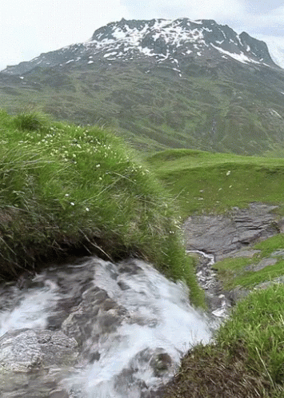


Flows of wealth
Notes:
Traditionally, we have focussed on redistribution after wealth is created
CWB is also about pre-distribution: designing inclusion in before the wealth is created

Slide 11

Community Wealth as Economic Plumbing?
Notes:
Traditionally, we have focussed on redistribution of wealth after its is created, CWB is also about pre-distribution during/before wealth is created

Slide 12
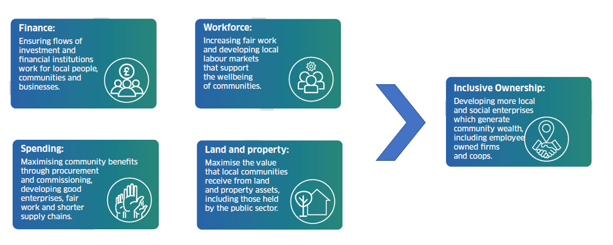
Pillars of CWB
Notes:
Traditionally, we have focussed on redistribution of wealth after its is created, CWB is also about pre-distribution during/before wealth is created

Slide 13
4 areas of work- Scotland
  Policy. Across range of SG policy areas.
  Practice. several pilot localities and regions over the past year.
    Ayrshire region, alongside 5 other areas - Clackmannanshire, South of Scotland, Western Isles, Tay Cities/Fife and Glasgow City Region.
    other areas, including South Lanarkshire, Moray, East Renfrewshire, Highland, West Lothian and Dundee City
  Movement building.
    Industry and economic sectors are integrating CWB principles into their development and delivery approaches.
  Legislation. ‘Community Wealth Building act’

Slide 14

    CHANGED ideas as to what matters in life?
    CHANGING how and where we work
    SHOWED how we can react in Public services
Collective Public Service

Slide 15
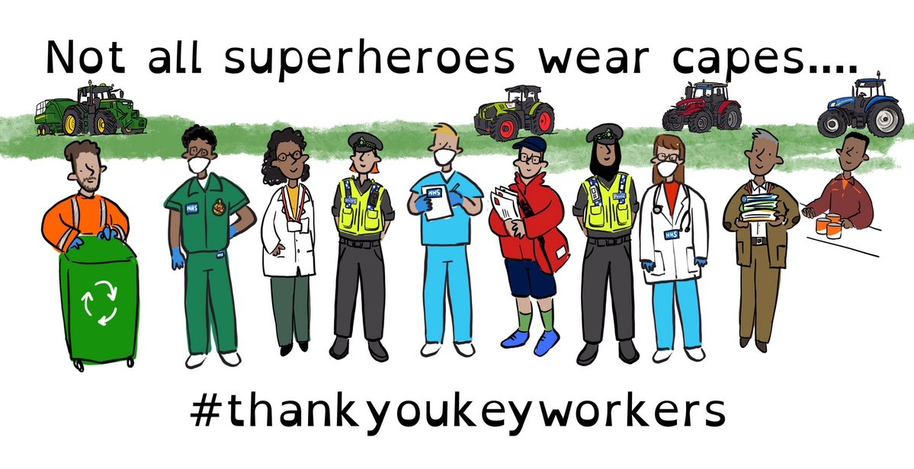
Covid is telling us about economic priorities

Slide 16
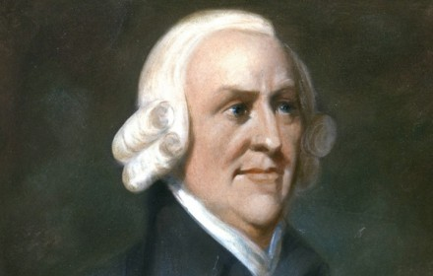
Empathy, care and concern is on the rise
‘Though our brother is on the rack, as long as we ourselves are at our ease, our senses will never inform us if what he suffers’
Adam Smith (1723– 1790) Scottish economist and philosopher.
Notes:
Covid has disrupted our sense of ease, we deeply imagined and experienced the pain of others. We as humans grew empathy.

Slide 17
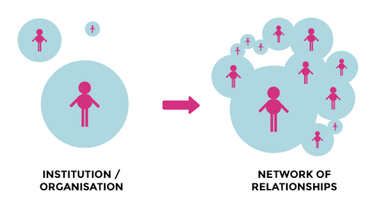
Notes:
No wrond door
Plan for place

Slide 18
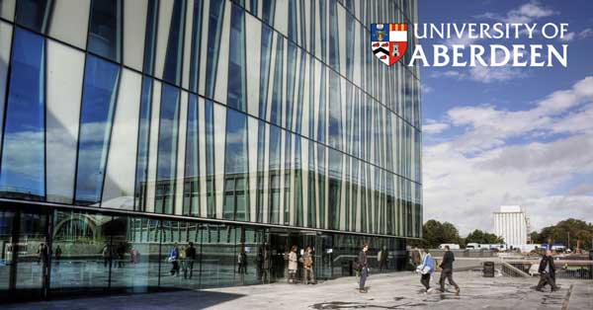






Anchor Institutions –place based approach
An anchor institution holds specific geographical ties to the area in which they exist e.g.. Hospitals, the Council, Police Scotland, Colleges and Universities.
“Sticky capital”: Financial, economic, intellectual, social, human- capital
Economic engine: Employer, purchaser, own land and property and an investor

Slide 19

Scotland’s Community Wealth Building
The future has to be a more relational
Notes:
Core economy

Slide 20
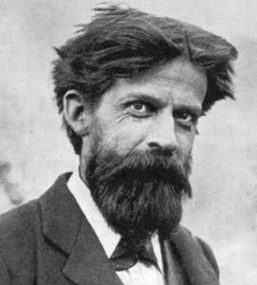
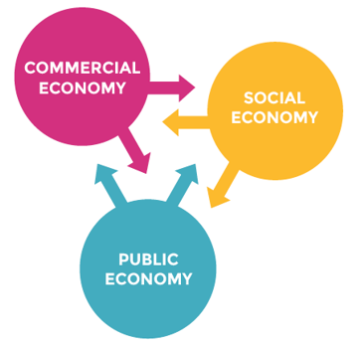
Collective Public service – Resilience
Patrick Geddes (1854-1932)
Scottish biologist, sociologist, geographer, and pioneering town planner
‘Resilience is an emergent property of a system – it’s not a result of any one of the system’s parts but of the synergy between all its parts.

Slide 21
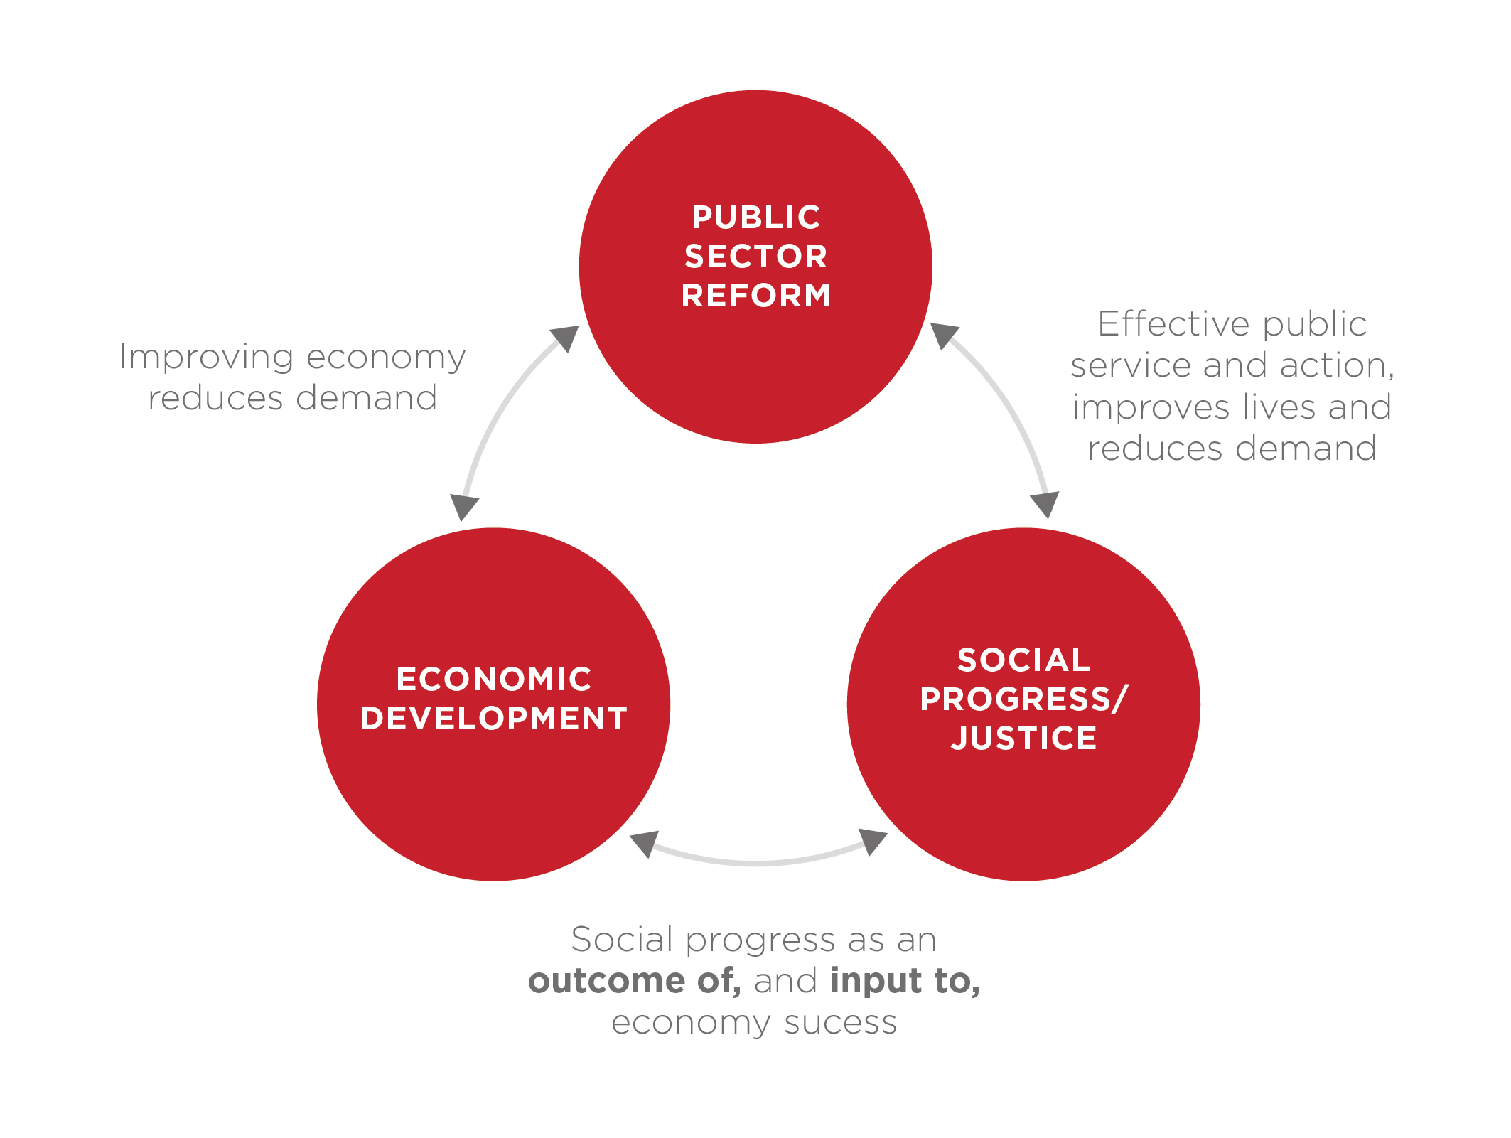
Notes:
Christie

Slide 22
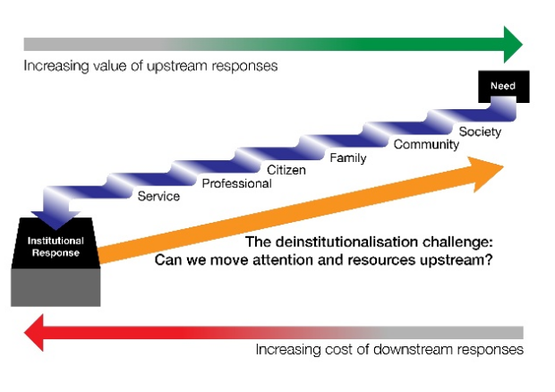

Slide 23
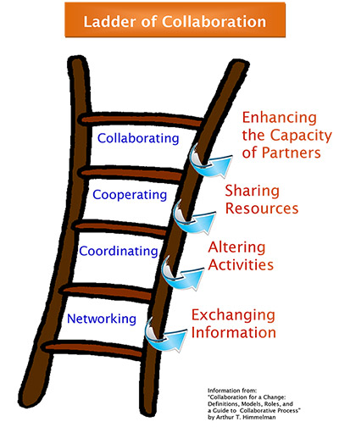

Slide 24
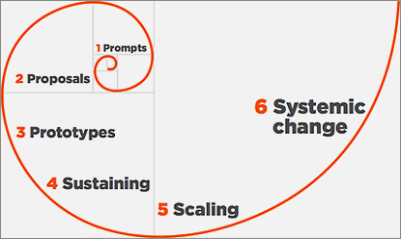
THE WALL OF MAINSTREAMING CHANGE
Experiment
Notes:
leadership

Slide 25
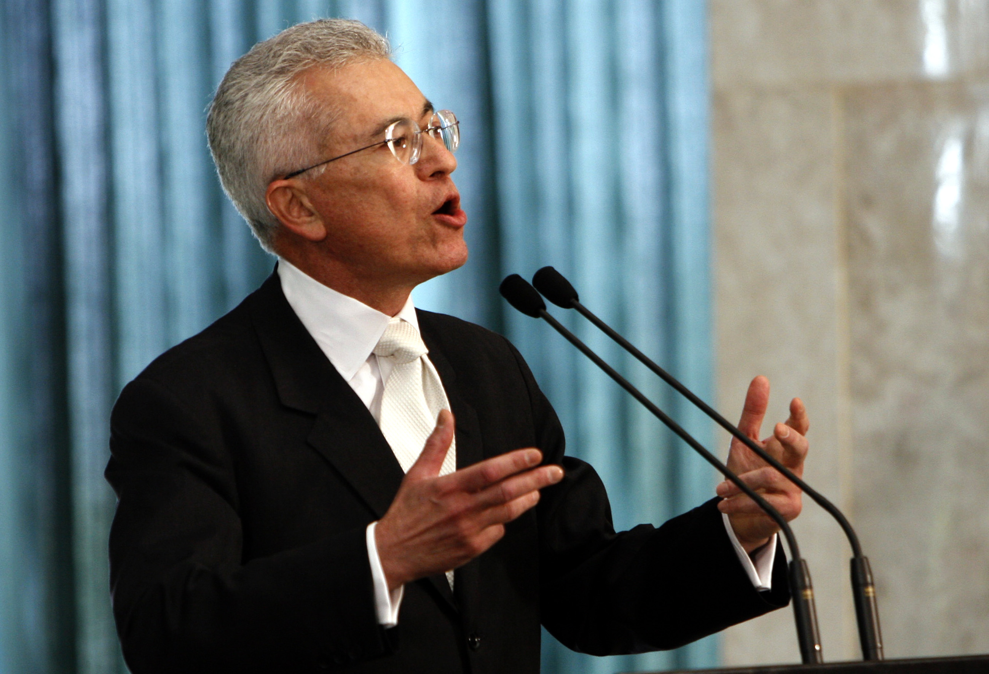
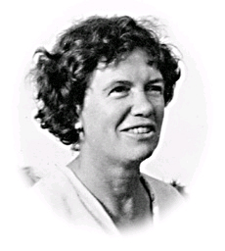
‘…Initiatives and experiments should exemplify and foreshadow a direction for society’
Roberto Unger
‘Never doubt that a small group of thoughtful, committed people can change the world. Indeed, it is the only thing that ever has’
Margaret Mead.

Slide 26
Thank you!
Neil McInroy, nmcinroy@democracycollaborative.org

