Slide 1


2017 - 2027
Local Outcome Improvement Plan
Version 1.1 • Published June 2019 • Fife Partnership Creating a Fairer Fife

Slide 2
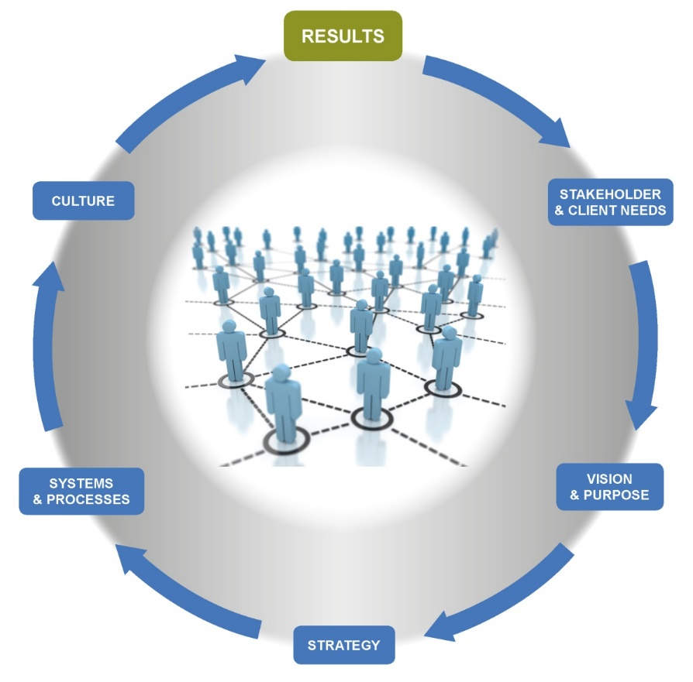
Organisational Effectiveness Model

Slide 3
Plan for Fife
Key Areas for Change
Place
All the resources Team Fife / Team Leven
No Wrong Door
The right place earlier Invest in relationship building
Community Wealth Building
Our resources as levers Economic diversity & fairness
Health & Well Being
Tackling inequality Prevention & community capacity

Slide 4
THE COMMUNITY PARADIGM
WHY PUBLIC SERVICES NEED RADICAL CHANGE AND HOW IT CAN BE ACHIEVED
Civic
State
WW2
1940
Market
Community
Mid 1980s
Emergent

Slide 5
“Prevention can ultimately only be successful when those at risk of illness, crime or crisis take the necessary steps to prevent it themselves with the supportive influence of communities and networks around them.
This cannot be done when power and resources are locked up in the institutions of public services overwhelmingly concerned with acute response rather than prevention.”

Slide 6
The Task
The output is…….
Recommendations to Leadership summit
2. The design is……..
Intent v progress
What could be – what’s the gap
What could make the difference
3. The requirement from yourself is……..
Invest yourself
Problem solving
3rd horizon perspective

