Slide 1
Health and Wellbeing
Workshop 2 – 29th November

Slide 2
Where we got to in workshop 1
Shared endeavour:
to increase physical activity, with social connectedness (by working across organisations)
NB issues around food and income inequalities are also critical and interdependent

Slide 3
Why this matters
Poor diet and physical inactivity - major risk factors for many chronic diseases, contribute to mild and moderate mental health issues, depression, anxiety and social isolation.
Physical inactivity is recognised as 1 of 4 leading modifiable risk factors for noncommunicable disease.
It’s estimated that physical inactivity contributes to almost 1 in 10 premature deaths from CHD, and 1 in 6 deaths from any cause. Direct financial cost to UK healthcare system estimated to be £1.2billion p.a.
Physical activity offers a protective effect against many chronic conditions, including coronary heart disease, obesity, Type 2 diabetes and mental health problems, and can increase social connectedness, reducing isolation

Slide 4
What’s meant by physical activity?
everyday activities: active travel (e.g. walking, cycling, wheeling), heavy housework, gardening, DIY, occupational activity
active recreation: recreational walking, cycling, active play, dance
sport: sport walking and cycling, swimming, formal and informal sport, structured competitive activity, exercise and fitness training and individual outdoor pursuits

Slide 5
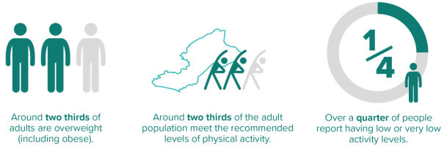
The picture in Fife

Slide 6
Proportion of adults meeting recommended levels declines with age
In all age groups men more likely to meet recommended levels than women.
Across Scotland, 71% of children aged 2-15 met physical activity levels for their age group… but participation in sports was lower in children aged 13-25.
51.8% of school pupils in Fife surveyed in 2020 said they normally travel to school in an active way. (Walking – 46%)

Slide 7
Impacts of Covid
renewed interest in outdoor physical exercise and access to green and blue spaces
increased inequality in greenspace visits
decline in activity amongst older people - especially in most deprived areas – leading to deconditioning and increase in falls

Slide 8
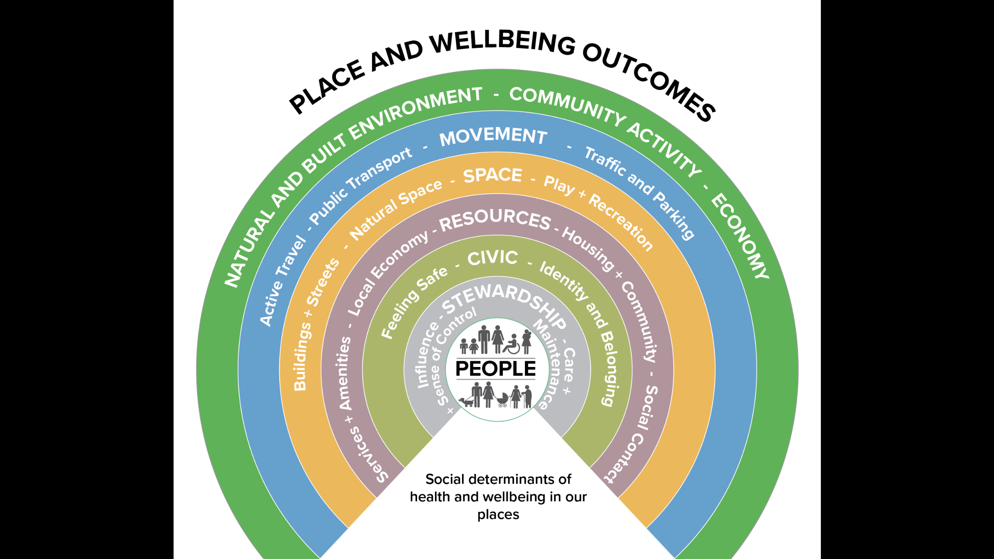
Place and Health

Slide 9

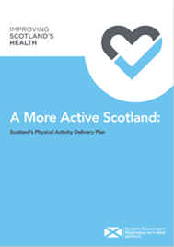

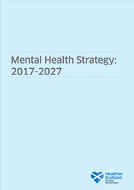

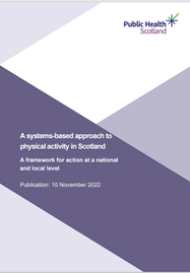

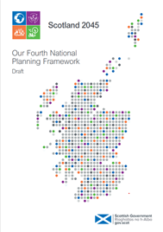

Policy context
Global and Scottish Govt target: 15% reduction in prevalence of physical inactivity in adults and adolescents by 2030

Slide 10
Where we want to get to
Our ambitions for Priority 6*
There are cultural and structural changes to support active travel, healthy eating and breastfeeding as norms
We have consistent approaches to healthy eating and physical activity across multiple sectors - health, education, welfare, social care, workplaces and the voluntary sector
Individuals and communities are empowered to access and participate in healthy eating and physical activity throughout the life course, including the ageing population and addressing food insecurity
* from DPH Fife annual report 2020-21

Slide 11
Themes identified from ‘homework’
What’s ‘live’:
  a range of workforce schemes and incentives to encourage physical activity
Opportunities:
  potential to use our strength as anchor institutions to open up our green spaces to local communities
  incorporate this work into workforce planning strategies for say the 10 major employers in Fife.

Slide 12
Current work
Physical Activity & Sport Strategy
4DX
Levenmouth pilot
Whole Systems Approach to diabetes prevention
Green Health Partnership

Slide 13
Learning from local – 4DX
What things have gone better than expected?
Process adoption and embracing new ways of working
Results to be proud of…
Legacy of collaboration and trust

Slide 14
Learning from local – 4DX
What can we build on, going forward?
Network of Local Area Teams
Area programming approach
Allowing time to build trust and behaviour change

Slide 15
Learning from local – 4DX
How can system leaders help?
Focus ‘our strategic priorities’
Shared commitments
Individual and team accountability
Credible collective data and evidence

Slide 16
Learning from local – Levenmouth targeted approach to physical activity
What things have gone better than expected?
Data Informing Practice
Through local discussion, understanding how true collaboration can add value to existing local programmes and priorities
Identifying key community organisations within the Levenmouth area that can add value to this work. Identify opportunities for partnership working
Exploring workforce support and development opportunities

Slide 17
Learning from local – Levenmouth
What can we build on, going forward?
Focus in on smaller bitesize priorities – 3 Areas
Collaborate with the unknown and uncomfortable
Build on Local Voice - Not to but with the Community
Use the learning from this significant test of change model to influence our prioritisation, planning and allocation of resources to drive equality, diversity and inclusion and reduce inequalities in sport and physical activity across all areas of Fife going forward.

Slide 18
Learning from local – Levenmouth
How can system leaders help?
Give time & allow for learning and failures and adaptation
Challenge standard/old approaches
Implement person/community centred ways of working
Accountability

Slide 19
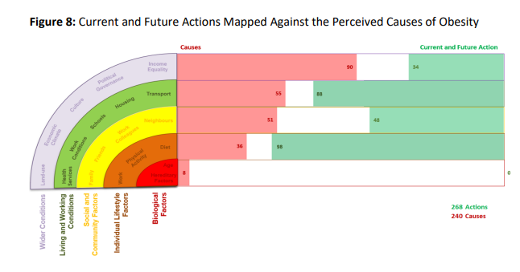
Learning from Fife’s whole systems work

Slide 20
Systems approach to physical activity
…moves away from short-term, solitary interventions and shifts our thinking towards strategic cross-sectoral efforts that work in a complementary way to maximise limited resources and increase population levels of physical activity.
(Public Health Scotland)

Slide 21
Public Health Scotland systems map for a more active Scotland
Simplified visual representation of a complex system
Helps partners share understanding of their role and opportunities for collaboration and joint action
Developed by overlaying variables that impact on physical activity alongside evidence-based actions

Slide 22
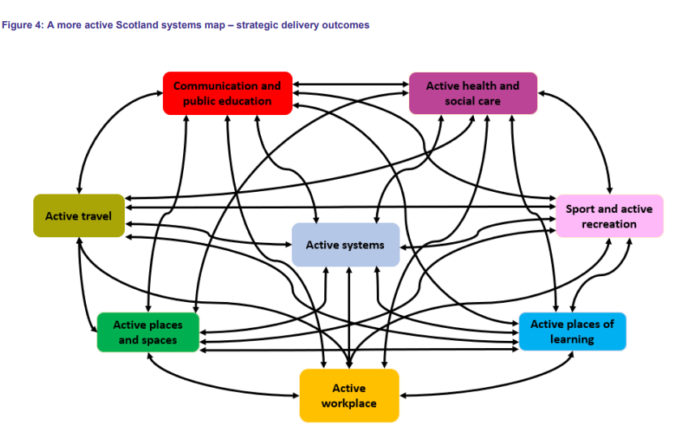

Slide 23
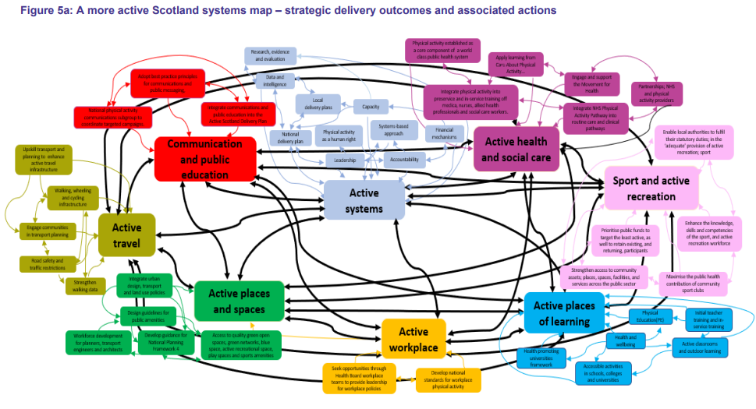

Slide 24
Workshop 2 – Task A (whole group)
Looking at the systems map, consider - where we could most usefully take collective action?
Notes:
Myron’s Maxims:
People own what they help create …
•Real change happens in real work …
•Those who do the work, do the change …
•Connect the system to more of itself …
•Start anywhere, follow everywhere …
•The process you use to get to the future is the future you get …

Slide 25
Workshop 2 – Task B (small groups)
Consider:
  Within this area, where could we make the biggest collective impact?
  What are our highest hopes?
  What are the actions we need to take?

