Slide 1

Introduction to Community Wealth Building
Gordon Mole
Head of Business & Employability gordon.mole@fife.gov.uk
Sinead O’Donnell
Project Manager
Communities Directorate
sinead.odonnell@fife.gov.uk

Slide 2
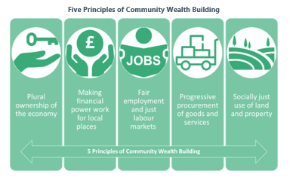
Community Wealth Building
“Community wealth building is about creating a fairer, more socially just economy. It is practical action, framed by progressive concepts.” CLES 2019.
Notes:
At the heart of the community wealth building approach are five strategies for harnessing existing resources to enable local economies to grow and develop from within. These are called the 5 pillars of CWB: Plural Ownership of the Economy, Making Financial Power Work for Local People, Fair Employment and Just Labour Markets, Socially Just Use of Land and Property.
The way in which organisations like local councils, hospitals, universities and colleges spend their money, employ people and use their land, property and financials assets can make a huge difference to a local area.
Used in the right way, these things can be used to generate wealth, jobs and opportunity for local people and give as many people as possible a stake in the local economy.

Slide 3
Fife - Anchor Institutions
Large Public Sector or Non-Profit Orgs
Tied to Place
Community Based Local Economic Development
Established Local Relationships
Substantial Purchasing Power
Community Wealth Building
Employ Significant Numbers of People

Slide 4
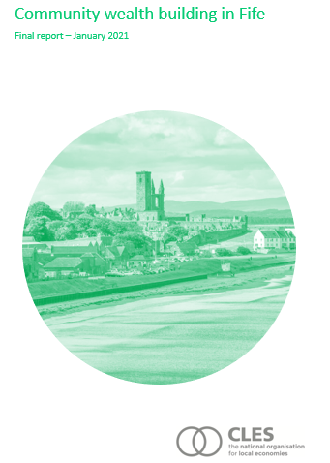
CLES Recommendations

Slide 5
CLES Recommendations
Theme: Fife as a community wealth building place
Develop an economic strategy for community wealth. Establish a Fife anchor network taskforce to drive community wealth building across the partnership. Build a community wealth building culture. Establish a community wealth building working group. All City Region Deal projects should follow the principles of community wealth building.
Theme: Progressive procurement of goods and services
6. Develop a community benefits procurement framework. 7. Provide community benefits training. 8. Widen out meet the market events. 9. Look to influence others.
Notes:
CLES has set out the following recommendations within its action plan report

Slide 6
CLES Recommendations
Theme: Making financial power work for local places
10. Support and promote credit unions and the Community Wealth Bank to become financial anchors. 11. Identify opportunities to work with the Fife Pension Fund for investment in assets.
Theme: Socially productive use of land and assets
12. Create a strategic asset register and support closer working to deliver this 13. Work with the anchor network taskforce to pool land for housing. 14. Explore the potential for a green building supply chain.
Theme: Fair employment and just labour markets
15. Undertake an employee mapping exercise and target interventions to the geographies of greatest need. 16. Develop an anchor network taskforce workstream related to pressing employment issues. 17. Develop a targeted good employment strategy

Slide 7
CLES Recommendations
Theme: Plural ownership of the economy
18. Consider a community wealth building hub to inform the continued development of the Council business support offer. 19. Explore opportunities for more public sector involvement in the care market. 20. Explore models for parent-led childcare and community transport providers.

Slide 8


Fife Partnership Public services working together

Slide 9
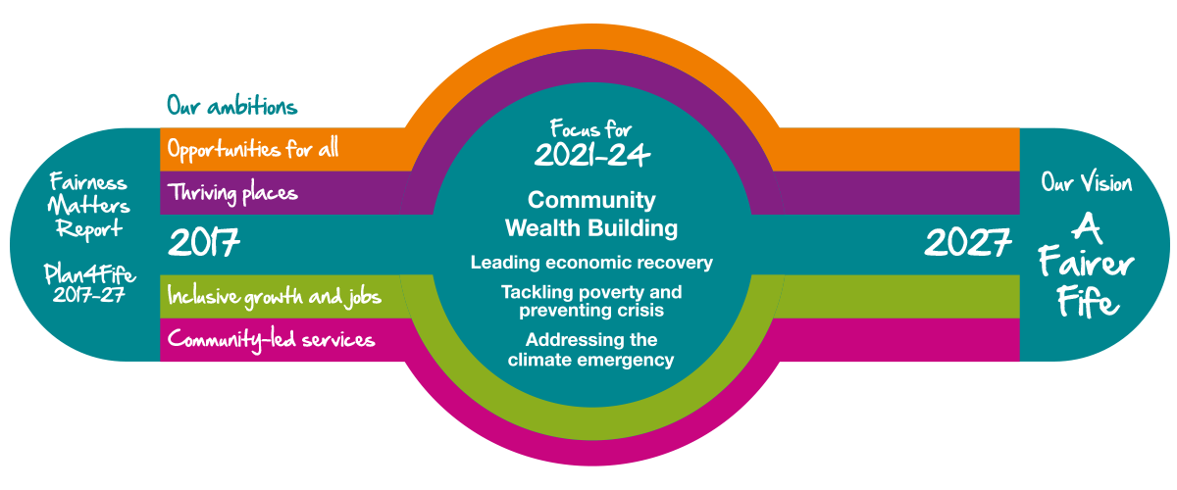
Our Plan for Fife: Recovery & Renewal 2021-2024
Building A New Kind of Public Service Partnership
Notes:
Thanks and end

Slide 10
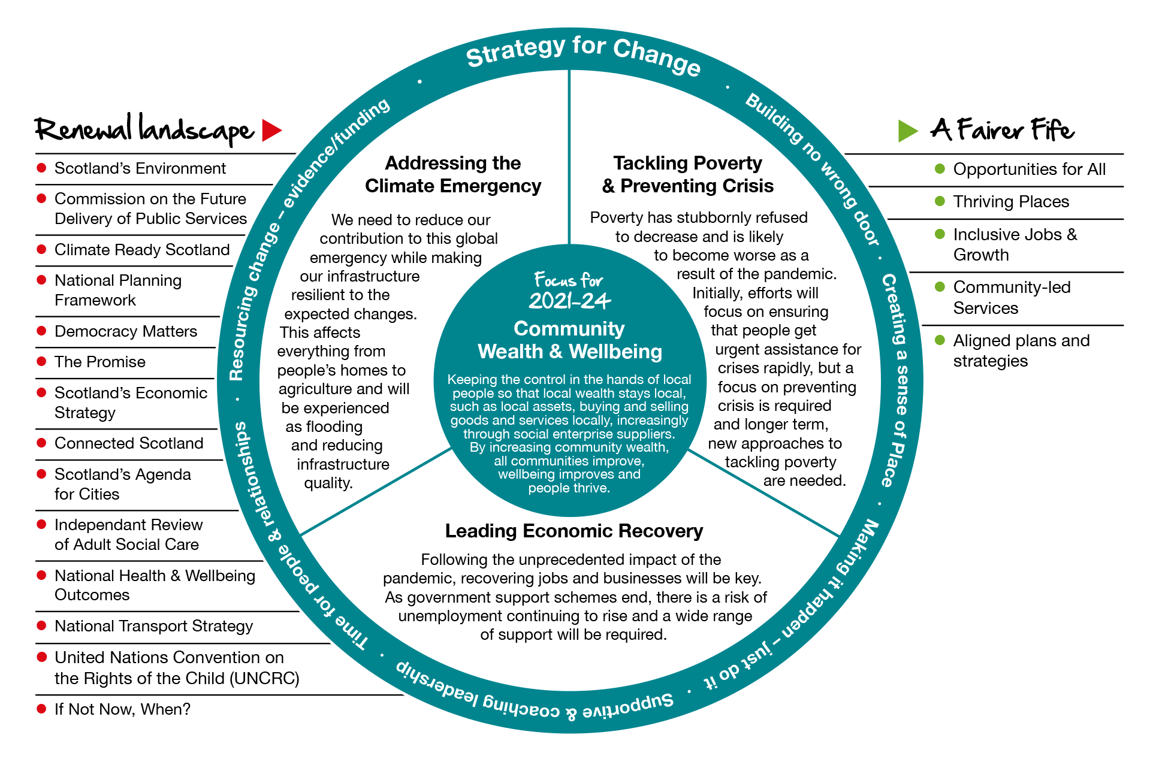

Slide 11
Our Commitments | Our Ambitions
Develop a CWB model of economic recovery and development Develop a CWB approach to the climate emergency Embed local people and place-based approaches across the Fife Partnership Redesign systems and processes to deliver wider social benefit through procurement, recruitment, fair employment and the use of land and assets Expand support for community ownership, social enterprise and community owned businesses through a new business support hub Further develop the role of credit unions and the CDFI to support financial resilience and wellbeing | Embedded CWB practice and culture in Fife Increased local procurement More Fife employers paying the Real Living Wage Increase in the number of social enterprises, co-operatives, and community owned businesses in Fife Increased recruitment from under-represented and deprived communities Greater availability of land and assets for productive community use Increased membership of Kingdom credit union and the (CDFI) in Fife Increased usage and value from community benefits clauses
Fife Partnership Public services working together

Slide 12
Community Wealth Building Support Group
Senior Partner Delivery Group:
Fife Council – various
NHS Fife - various
Fife College
Fife Voluntary Action
University of St Andrews
Green Lights:
CWB Delivery Plan 2022-2023
CWB Anchor Charter
Project Scoping
Priority Projects
Procurement
Recruitment
Real Living Wage Town
Anchor Asset Register
Building A New Kind of Public Service Partnership

Slide 13
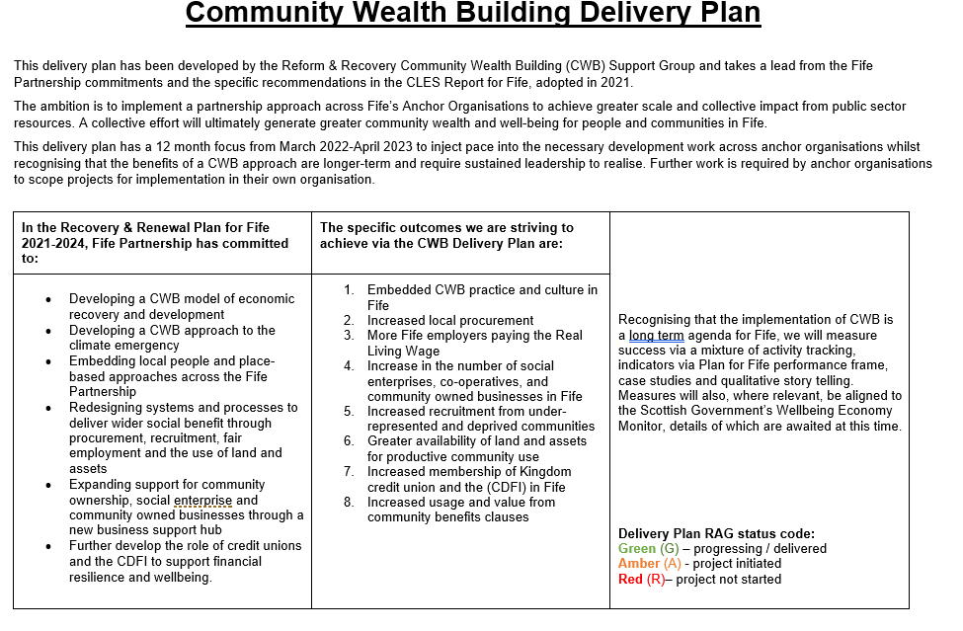
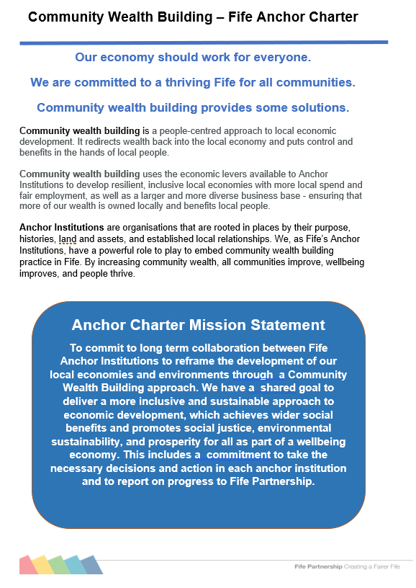
Fife CWB- Progress

Slide 14
Procurement - Fife Position
FC Spend Local and SME Status
FC Spend – Wider Local Impact
 | 2019-20 £M | %
Total Fife Council Spend* | 518.658
Total spend with Fife Suppliers (KY postcode) | 196.639 | 37.91
Every £1 spent locally on goods and services with local SMEs generates an additional 63p for the local economy….FC third party spend contributed and additional £123.88m
Companies with Fife Presence
No. of companies with Fife presence (i.e. depot/branch and/or Fife based employees for Fife contract) i.e. over and above those with HQ in Fife | 20
Spend with these companies | £42.620m
Approx. average employment of Fife residents | 49%
Companies with Fife Base - HQ
No. of companies with HQ based in Fife | 26
Spend with these Fife based companies | £35.773m
Approx. average employment of Fife residents | 93%

Slide 15

Glenrothes: August 2019 = 9 Accreditations March 2020 = 18 Accreditations
Fife: August 2019 = 40 Accreditations March 2020 = 82 Accreditations

Slide 16
CBC – Fife Experience
Community Benefit Type (Number) | 2018/19 | 2019/20
Jobs | 15 | 134
Apprenticeships | 9 | 116
Qualifications achieved through training | 13 | 50
Approx: £18m
In community benefits

Slide 17
Plural Ownership of the Economy - Community Asset Transfer
Community Wealth Building
Plural Ownership
Land and Assets
Part 5 of the Community Empowerment (Scotland) Act 2015
…enables community bodies to request ownership, lease or management of publicly owned buildings or land
£1.1m LOSS of capital receipt by Fife Council
£1.1m INVESTMENT to Fife communities

Slide 18








Scotland’s National Strategy
for Economic Transformation:
Delivering Economic Prosperity
(Published: 1st March 2022)
Notes:
So, to start off, I’ll try and give you an overview of the new NSET, which was finally published on 1st March, after a number of delays.

Slide 19
National Strategy for Economic Transformation:
Vision, Ambition & Five Key Programmes
Vision
A Well-Being Economy
Thriving across Economic, Social & Environmental Dimensions
Ambition
Fairer
Ensuring that work pays for everyone through better wages and fair work, reducing poverty
and improving life chances
Wealthier
Driving an increase in productivity by building an internationally competitive economy founded on entrepreneurship and innovation
Greener
Demonstrating global leadership in tackling climate change, delivering a just transition to net zero and rebuilding natural capital
Programmes of Action
Entrepreneurial People & Culture
New Market
Opportunities
Productive Businesses
& Regions
Skilled Workforce
A Fairer & More Equal Society
A Culture of Delivery
Notes:
So this slide provides an overview of the new NSET, and if you take anything away with you from today it should probably be this.
The Vision highlights a move towards a well-being economy
Below that we have three fairly familiar ambitions of a Fairer, Wealthier and Greener Scottish Economy
The strategy then identifies five inter-connected and mutually reinforcing policy programmes to deliver on these ambitions
Underpinned by sixth programme of action that aims to promote a stronger Culture of Delivery
But … no new monies !

Slide 20
Programme
A Fairer & More Equal Society
Re-orient our economy to wellbeing and fair work, to deliver the higher
rates of employment and wage growth that will significantly reduce poverty,
particularly child structural poverty, and improve health, cultural and
social outcomes for disadvantaged families and communities
5
Projects
Tackle poverty through
fairer pay and conditions
Eradicate structural barriers to
participating in the labour market
14
15
Actions include:
Apply Fair Work conditionality to grants, requiring payment of the real Living Wage, and channels for effective workers’ voice
Deliver on the commitment to require the payment of the real Living Wage in Scottish Government contracts
Work with employers and trades unions in sectors where low pay and precarious work is most prevalent to achieve higher standards of pay and work security
Build on findings from the Business Purpose Commission Report to inform how businesses can deliver positive impacts on prosperity, wellbeing (including tackling child poverty) and environmental sustainability.
Support parents to increase incomes from employment
Simplify the employability system by implementing No One Left Behind, combining funding streams and transferring investment from national to local governance.
Ensure Every Contact Counts in delivering an aligned and integrated offer of support to those seeking to move towards, into, or progressing within the labour market
Take further steps to remove barriers to employment and career advancement for disabled people, women, those with care experience and people from minority ethnic groups
Build on principles of Young Persons Guarantee to develop an all-age guarantee of support for the most disadvantaged in the labour market
Establish a Centre of Expertise in Equality & Human Rights
Notes:
Programme 5 focusses on Fairness and Equality
Using public sector leverage to encourage fair work conditions
Addressing barriers to employment for disadvantaged groups
Simplified/streamlined employment support through No One Left Behind
Support for young people and positive destinations

Slide 21
More On CWB!
Elected Member Briefing Note: Community Wealth Building (improvementservice.org.uk)
Community Wealth Building Centre of Excellence | CLES
Community Wealth Building Case Studies - Scotland’s Centre for Regional Inclusive Growth
About The Democracy Collaborative
Community wealth building: what next? (democracycollaborative.org)
Community Wealth Building in action - Preston City Council
Delivering Positive Change in Scotland – Ted Howard and Tom Arthur MSP

