Slide 1
Health and Wellbeing
Workshop 3 – 12th December

Slide 2
Where we got to in workshop 1
Shared endeavour:
to increase physical activity, with social connectedness (by working across organisations)
NB issues around food and income inequalities are also critical and interdependent

Slide 3
Where we got to in workshop 2
the “case” for physical activity
learning from local innovations
a systems-based approach

Slide 4
A reminder – the systems approach
…moves away from short-term, solitary interventions and shifts our thinking towards strategic cross-sectoral efforts that work in a complementary way to maximise limited resources and increase population levels of physical activity.
(Public Health Scotland)

Slide 5
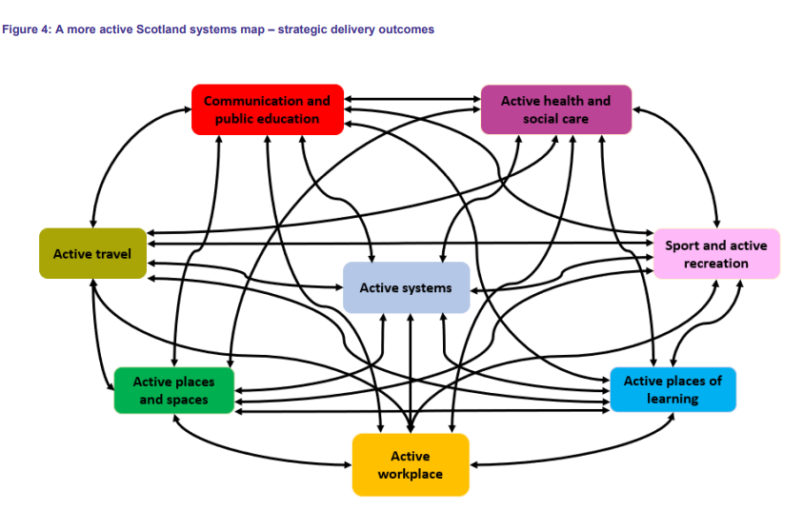

Slide 6
Our chosen areas of focus
Active places and spaces
Active workplace
Sport and active recreation
We acknowledged that these areas are also critical and should be taken forward in future work:
Active health and social care
Active travel

Slide 7
Our desired state
Neighbourhood design that encourages activity and connection
Better use of our green spaces
Organisations with wellbeing at core (recruitment, staff support, work practices)
Targeted interventions (least active / inequalities / transition points) while achieving a shift across the population
Connected community connectors and clear communication
Physical activity taken seriously – impact understood
Work taken forward across the system
Continued collaborative leadership, inclusion of missing voices
Notes:
The next 3 slides draw together workshop 2 discussions and your feedback at checkout. These were our highest hopes for where we would like to be:
Our neighbourhoods are designed to enable and encourage people of all ages to be physically active and connected.
Our organisations make better use of our collective assets – in particular, our green spaces - for the benefit of staff and the wider community. A focus on green space can impact across all delivery outcomes.
Our shared commitment to wellbeing means our organisations are attractive to new recruits and support employees to be as well as they can be.
We target interventions to those who are least active / facing the starkest inequalities, and those at life transition points, while encouraging a shift in activity levels across the population.
There is a large and connected network of ‘community connectors’, and our staff and communities can easily access information about the range of services and opportunities to be active.
We take physical activity seriously. The significant impact of physical inactivity on physical and mental health, and resultant pressure on services, is understood. Physical activity is recognised to be as effective as other health and wellbeing ‘interventions’.
We take forward work across the whole system, including active travel and active health and social care.
We continue this process of collaborative leadership and bring in missing voices – we “connect the system to more of itself”.

Slide 8
Our current state
Disconnect between different parts of the system
Potential to do more to open up our green spaces
Challenges around staff recruitment, absence, wellbeing
Lack of data / understanding of our most inactive
Existing opportunities not coordinated or communicated clearly
Physical activity seen as the ‘poor relation’
Immediate operational pressures, concerns around budgets/risks
Notes:
In our discussions we identified some features of our current state:
There is disconnect between different parts of the system involved in place planning.
We could do much more to use our strengths as anchor institutions to open up green spaces to our communities.
We have serious and increasing challenges around recruitment, absence rates, staff wellbeing.
We don’t have enough understanding of who the most inactive in our population are and how to reach them most effectively.
There are already lots of services and opportunities to take part in physical activity, but they aren’t coordinated or communicated clearly.
Physical activity is seen as a ‘nice to do’ or ‘poor relation’ rather than a major factor in health and wellbeing across population groups
Immediate operational pressures are reducing capacity for teams to raise their gaze to the longer term.
There are concerns and a desire for clarity around budgets and risk
The strong examples of work locally and further afield have some common threads. These include: clear focus, shared commitment, supported and supportive leadership, accountability, credible data, genuine empowerment of frontline staff and communities, willingness to challenge and change old ways of working, giving time, and allowing for ‘failures’ and adaptations.

Slide 9
Learning from local
clear focus, shared commitment
supported and supportive leadership
strong ‘architecture’, accountability
credible data
building on community voice
multi-disciplinary teams focused around place
genuine empowerment of staff and communities
challenging old ways of working
giving time, and allowing for ‘failures’ and adaptations
Notes:
The strong examples of local work we heard about in workshop 2 had some common threads.

Slide 10
Case studies
Newham Community Health Champions
Put power in the hands of the community
Be honest
Respond on the community’s timeline, not the Council’s timeline
Trust – and earn trust
Meet people where they are not where the system / officials are
Connect into policy and practice – share what we hear
Share information that Champions can use – but don’t tell Champions what to do
Healthier Fleetwood
Creating a healthier community (not just treating illnesses)
Building connection, confidence, control
Activities for people to come together and become ‘doers’ (rather than done to)
Shared commitment across partners
Results:
improvements in mental / physical health
reduction in mental health prescriptions
reduction in use of services - 20% reduction in A&E attendances over 2 years
Notes:
The pre-reading we shared before workshop 2 (available on Leadership Summits website) included some case studies. Some of the learning:

Slide 11
Summit masterclasses https://our.fife.scot/leadership
Prof. Catherine Needham – Author of 21st Century Public Servant
emphasised the power of common purpose and the leadership skills needed to support successful service redesign and whole system change
Adam Lent & Jessica Studdert – New Local, The Community Paradigm & Community Power Evidence Base
set out the case for a fundamental shift in how public services work – to share power with people rather than hoard it. Provided the evidence of the 6 benefits of community powered approaches.
Chris Naylor – London Borough of Barking & Dagenham, Community Solutions
promoted a go big or go home approach. Advocated the issue one of design in public services – a structural problem and capability and not necessarily a policy problem. Key to success is using data understand problems and know your residents and having the capability to act in single community focussed directorate / partner arrangement.
Alison Trimble – The Kings Fund, Leading in Whole Systems
Presented the challenges of leading across systems as well as in organisations and communities and the dilemmas of place. Advocated using place to pull together a public service micro-system to discuss and generate new ways of pulling together

Slide 12
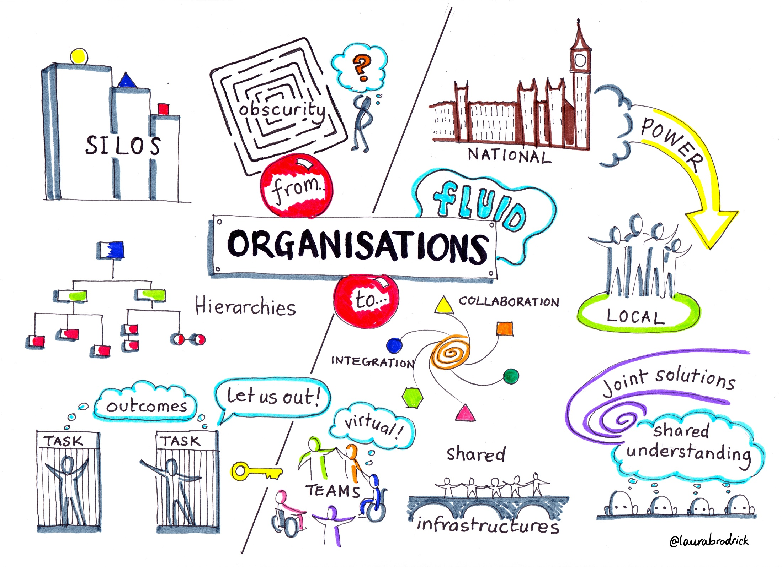
Organisational design
Notes:
Your feedback at the last workshops asked us to look at interactions and overlaps with other summit workstreams.
Common threads emerging from Place and No Wrong Door workstreams are around how we work and design our services.
This infographic shows the current state: operating in the context of narrowly defined thematic service structures, vertical hierarchies, silos, often procedure-driven rather than working through an integrated, collaborative and place-based approach.

Slide 13
Task 1: the design brief – what would we need to close the gap?
Planning
For example…
Shared commitment to prioritising physical activity
Data and evidence from varied sources, including community voices, to help us understand the most inactive 25%
Resources
For example…
Our green spaces
Funds pooled and prioritised to target least active and those at life transition points
Organisational Design
For example…
Services and service settings are designed to encourage physical activity
Supportive built and social environments
Governance
For example…
Programme Board for physical activity
Joint green space strategy
Notes:
In this workshop, we’re asking you to think about what it would take to close the gap between our current and desired states, in terms of 4 aspects of a design ‘brief’.
Looking at each of the themes, what would it mean for the way we –
Plan our work?
Use our resources?
Design our organisations / services / teams?
Drive, monitor and evaluate our work?

Slide 14
Task 2: our recommendations
For each of the 4 aspects of the design brief – what are the 3 reforms / actions we need Fife Partnership to work towards?

